Slide 1
Word Edifice In Android
Department of Computer Science
Final Masters Project Presentation For CS595

Slide 2
Roles and Responsibilities
RADHIKA REDDY GUDURI (13621)
RAJANARSIMHA REDDY (12519)
ARUN KUMAR GANTA (13677)
PRETHI POLAMANI (14067)
RAJASEKHAR REDDY VUSIKE (12832)
SAI CHARAN REDDY (12586)
PAVAN KUMAR (13267)
PRADEEP REDDY TERA (14425)
PREM KARTHIK (12580)
VIJAY KUMAR (13154)
Under the esteemed guidance of
Dr Z.Shi

Slide 3
Topics
Objective
Scope of the Project
Technical Specifications
Sequence Diagram
Class Diagram
State Chart Diagram
Work breakdown Structure
Risk Analysis
Overall Budget
Source code
Working Demo
Conclusion

Slide 4
Objective
We intend to provide our customers with a mobile software using which one can enhance their vocabulary. It is like word gaming and software which emphasis on providing the words based on the first and last alphabet(letter) of the word given as input.
It provides best gaming experience from beginning to end, easy-to-follow instructions , high quality and fast service.

Slide 5
Scope of the project
One of the fastest growing industries is mobile industry. There are many competitors in this area who are doing research and development on new platforms & user experience. One such technology is Android from Google which is supported for Google phones. These phones are described as next Generation mobiles [As described by Google]. Developing application for such mobile phones using the open source android SDK is quite interesting. This makes the application call history quite easy, efficient, flexible and economic.

Slide 6
Technical Specifications:
Java
Android SDK 1.5
PROCESSOR : (min) Intel Pentium P2 processor
RAM : (min) 128
HARD DISK : 160GB

Slide 7
Modules
Word speaker: word speaker converts speech to text and generates the word. It also converts the user voice into text.
Word collector: Word collector gets the word from the database. It collects words dynamically from the database with help of user word.
Meaning teller: Meaning teller converts the text given by the user to speech and reads the meaning of the word.

Slide 8
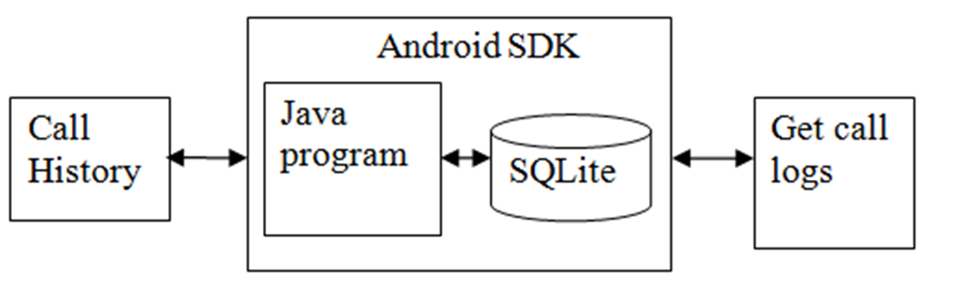
System Design

Slide 9
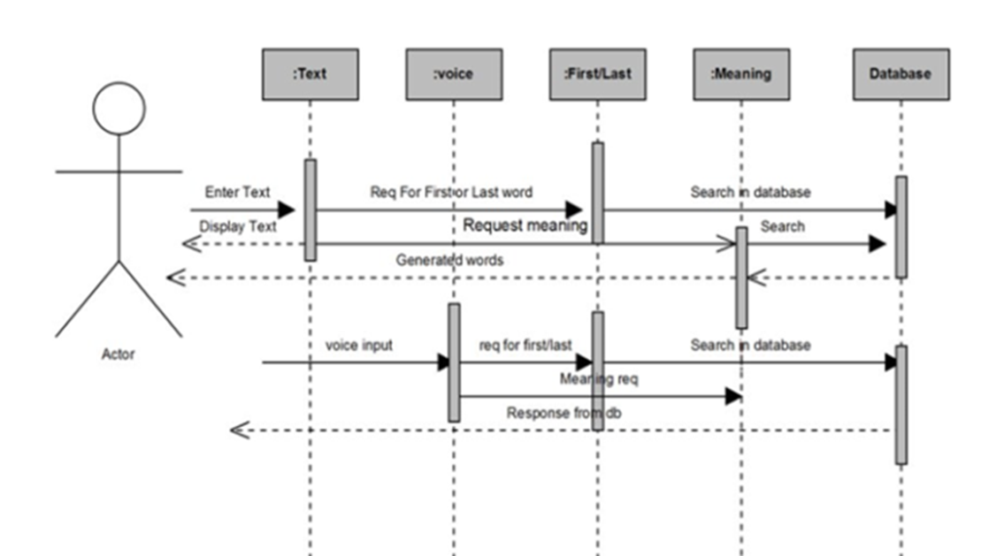
Sequence Diagram

Slide 10
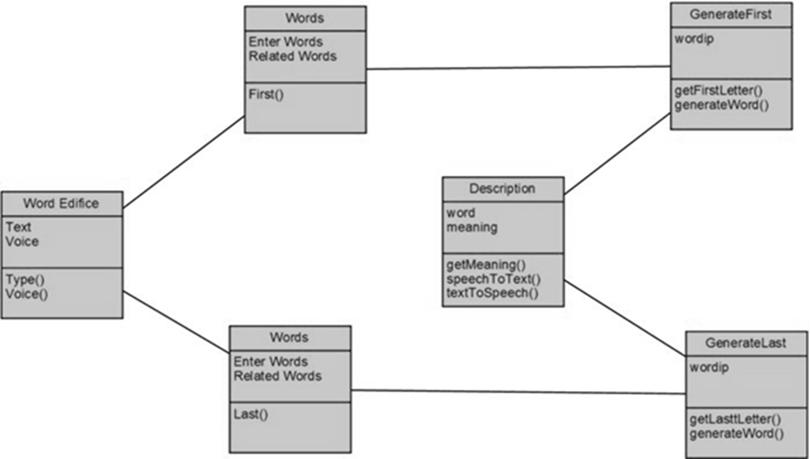
Class Diagram

Slide 11
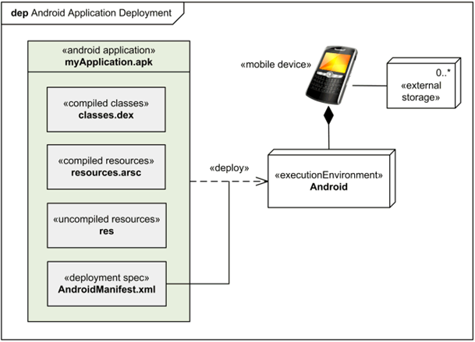
State Chart Diagram

Slide 12
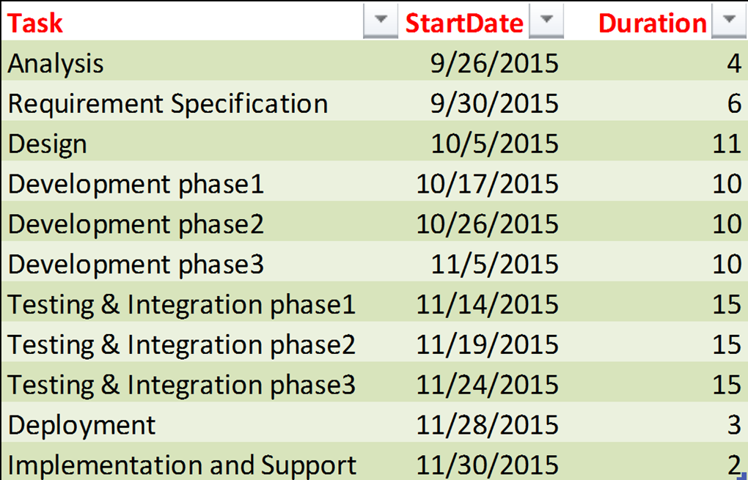
Work Breakdown Structure

Slide 13
Risk Analysis
Application should be stable enough to be tested.
Completing the project under a time constraint.
Integration

Slide 14
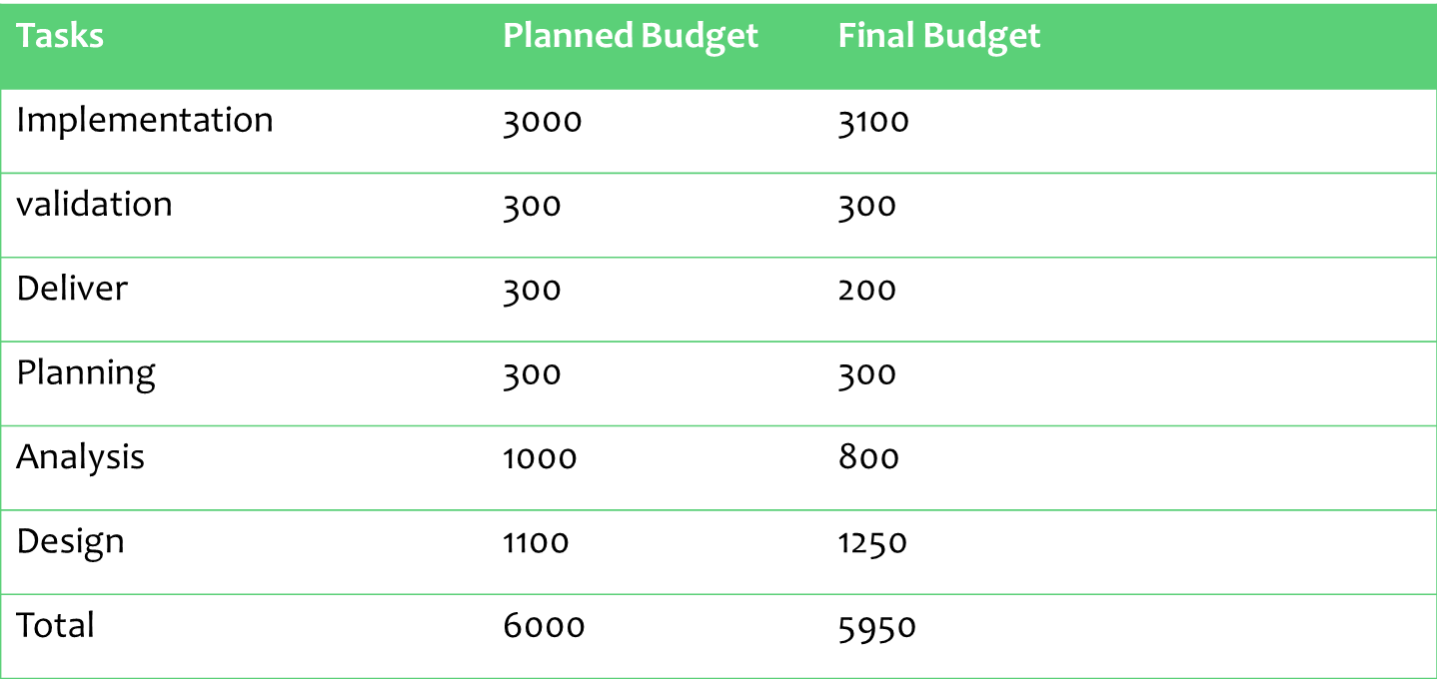
OVERALL BUDGET

Slide 15
How Source Code Managed
Coding is done in Java Language
Implementation: An effort was made to satisfy the following goals in order specified.
Minimization of Response Time.
Clarity and Simplicity of the Code.
Minimization of Coding.

Slide 16
Testing & Validation
Errors may begin to occur at the very inception of the process where the objectives may be erroneously or imperfectly specified, as well as in later design and development stages.

Slide 17
Testing Techniques
Testing is the process of executing a program with the intention of finding errors. The various test strategies used for testing the software are as follows.
UNIT TESTING
INTEGRATION TESTING
VALIDATION TESTING
SYSTEM TESTING

Slide 18
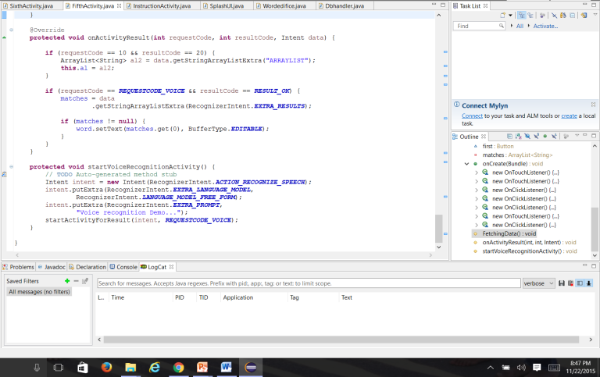
Execution

Slide 19
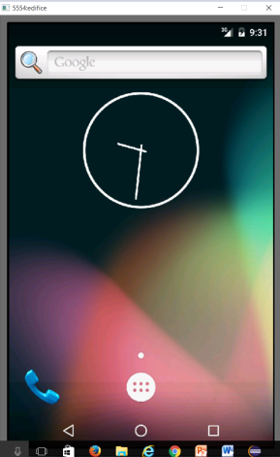
Working Demo

Slide 20
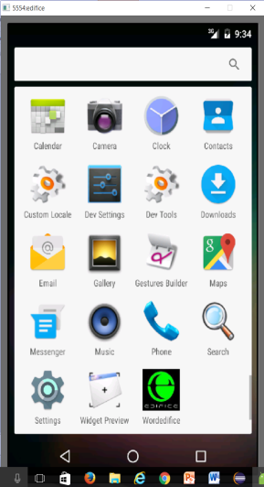
This Shows Edifice Application Installed

Slide 21
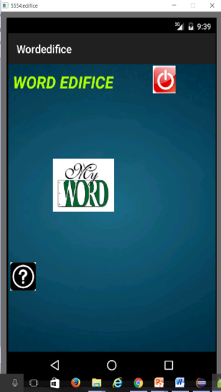

Slide 22
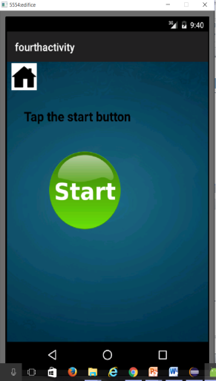
This is how we start our Application

Slide 23
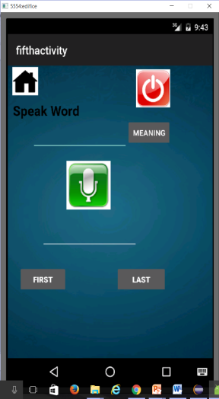
Let’s Give an Input

Slide 24
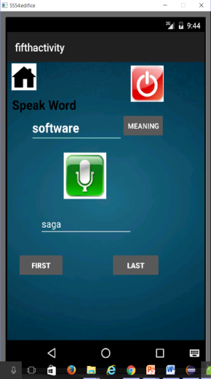
Example

Slide 25
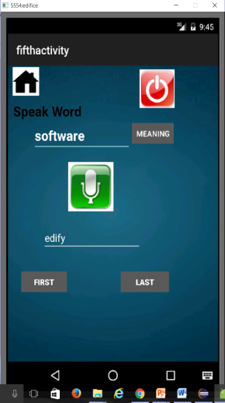
Example

Slide 26
Conclusion
Word Edifice is an attractive gaming app Which is both intellectual and entertainer. Word Edifice in Android will automatically find the meanings of the words spoken by the user.

Slide 27


